Slide 1

Statistics for Data Science
Project
ABHINAV BHUSHAN – PES1UG19CS017
ADITHYA P – PES1UG19CS028
ADITYA SRINIVASA – PES1UG19CS034
AADITYA SHAH – PES1UG19CS003
SEM 3, A SECTION

Slide 2
The Dataset
NETFLIX TV SHOWS AND MOVIES
This dataset consists of TV shows and movies available on Netflix as of 2019

Slide 3
Categories of Dataset
show_id: ID of a particular show/movie
type: classifies as either show or movie
title: Title of show/movie
director: Director of show/movie
cast: Cast of show/movie
country: The country in which the show/movie was released
date_added: The date on which the show/movie was added to Netflix
release_year: The date on which the show/movie was released
rating: Describes what audience the show/movie is rated for
duration: The runtime of show/movie
listed_in: Genre of the show/movie
description: Brief description of the show/movie

Slide 4
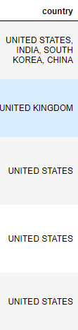
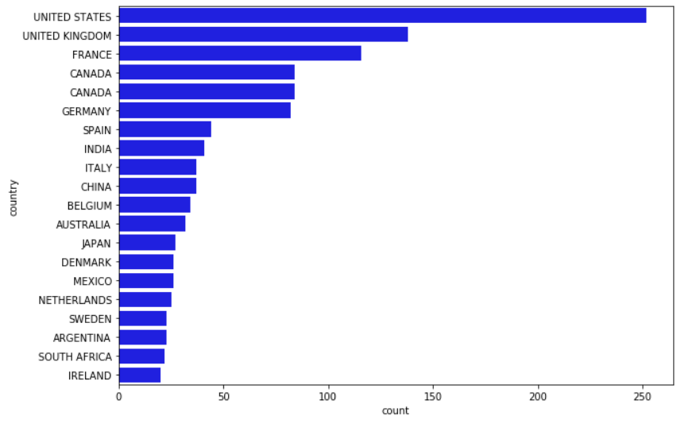
Top 20 Countries With the Most Netflix Content in the World

Slide 5
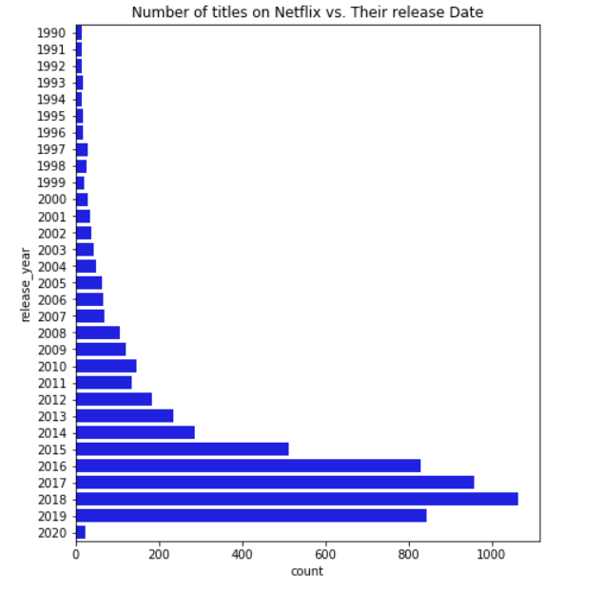
Number of Netflix Titles vs Their Release Date
6234 Titles

Slide 6

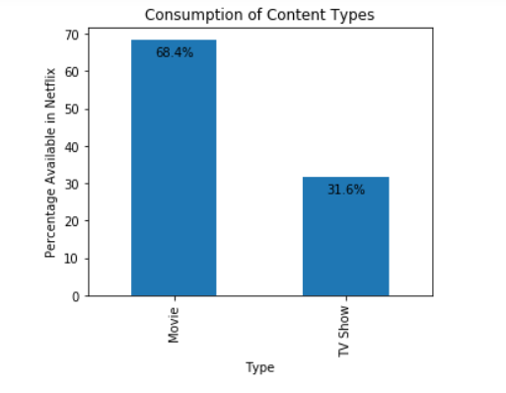
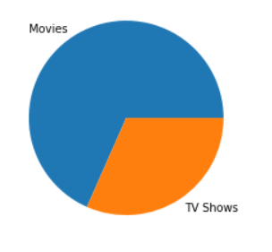
Consumption of Content Type on Netflix

Slide 7
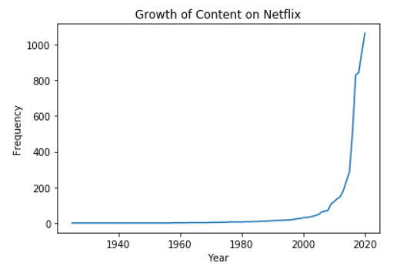
Growth of Content on Netflix

Slide 8
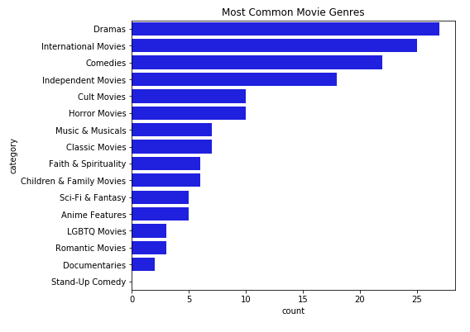
Most Common Movie Genres

Slide 9
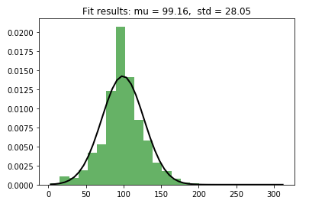
Probability Distribution Function Plot for durations of movies in Netflix (in minutes)

Slide 10
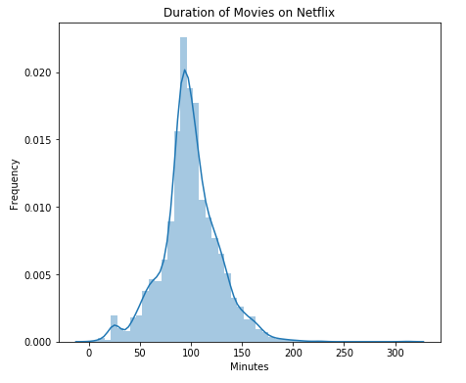
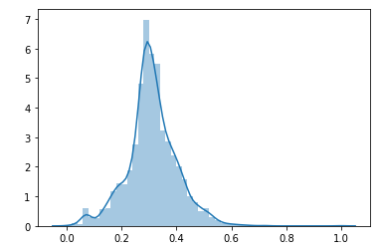
Normalization of Duration

Slide 11
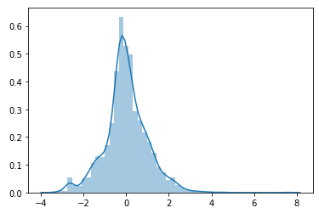
Standardized Normal Distribution for Duration

Slide 12
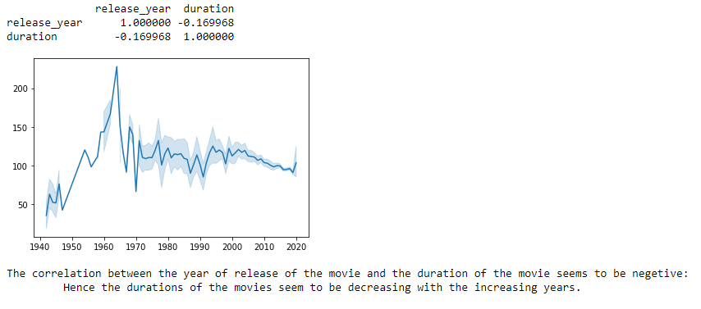
Correlation Between Year of Release of Movie and the Duration of the Movie

Slide 13
Hypothesis Testing
Hypothesis: To find if there a significant relation between the average duration of the movies on Netflix and the countries they are aired in.
NULL Hypothesis: There is no relation
Alternate Hypothesis: There is a significant relation
Method of Hypothesis Testing: CHI SQUARED TEST

Slide 14
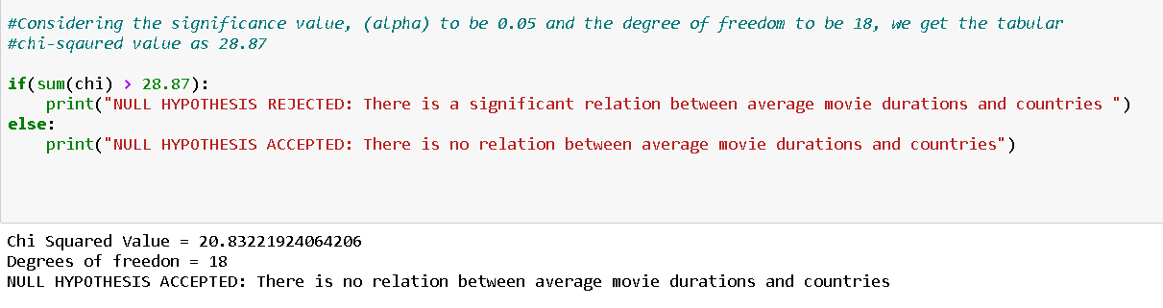
Result of Chi Squared Test
Since the value of Calculated Chi² < Tabular Chi², the NULL hypothesis is accepted which implies that there is no significant relation between the average duration of movies and countries.

Slide 15
Thank You

